Slide 1

Software Test Results
Yuval Raz | Raz Linetzki
January 2021

Slide 2
Agenda
Market overview
Product overview
Testing procedure and results
Bug examples
Recommendations and references
Conclusions

Slide 3
The Zimmer market timeline
Market peaks (9,000 units)
Open skies initiative
Zimmer law
The Zimmer tourism golden age
7,500 Units
Airbnb enters Israeli market
2000
2011
2013
2018
1994
2008
2012
2015
2020
Zimmer tourism culture begins
8100 Units
The ministry
of tourism initiative
(IBB)
6,500 units \
2,000 owners \
1,500 units rented
to students
Covid-19 Virus
BDO, 2013 | Central Bureau of Statistics | The Marker 2015
Notes:
1994 – Rise of the Zimmer touring culture is Israel (83 days of occupancy)*
2000 – Golden age
2008 – 8100 units^
2011 – IBB (Israel’s Bed & Breakfast) – ministry of tourism initiative
2012 – 7500 units^
2013 – Downfall - Open skies (40% off flights – X2 more outbound flights)
2013 – 137 days of occupancy* Zimmer law
2013 – 9000 units^
2013 – 453 NIS AVG price per night*
2013 – 500,000,000 NIS revenue*
2015 – 6500 unitsin the hands of 2000 owners@
2015 – 24% occupancy | 61% occupancy in hotels@
2018 – Airbnb
2020 – 1500 rental places@
*BDO 2013 | ^Central Bureau of Statistics | @The Marker 2015

Slide 4

“Zimmer” is a central player in the local tourism arena
Pioneered in the 80’s as a call center for Zimmer reservations in the Galilee.
Pioneered the tourism milieu in 1997 with www.zimmer.co.il
More than 1000 units advertised.
Hundreds of attractions.
More than 4 million users visit the website in a year (web).
More than 25 million page visits in a year (web).
First page in Google search engine.

Slide 5

Zimmer’s goal is to connect between unit owners and users looking for a local stay
The application is a platform for Zimmer owners to advertise their units; the units page is designed and controlled by the unit’s owner.
Users can search and filter their preferences and look for units. The user then calls the owner or fills a form in request for a price quote.

Slide 6
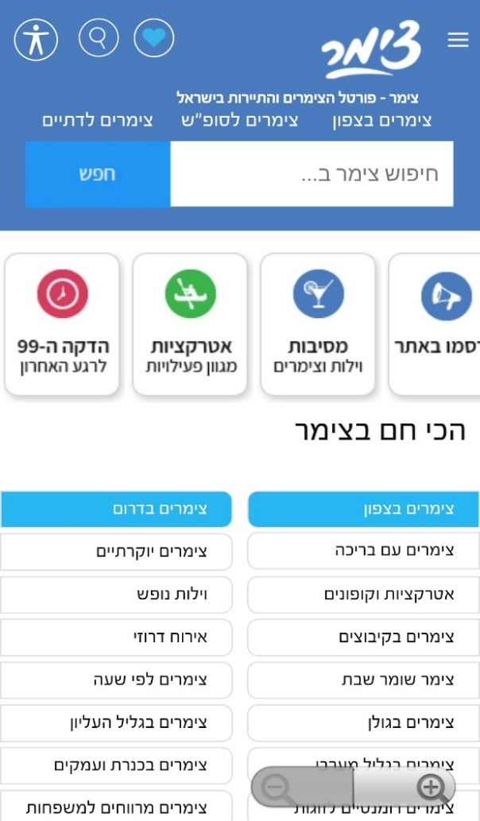
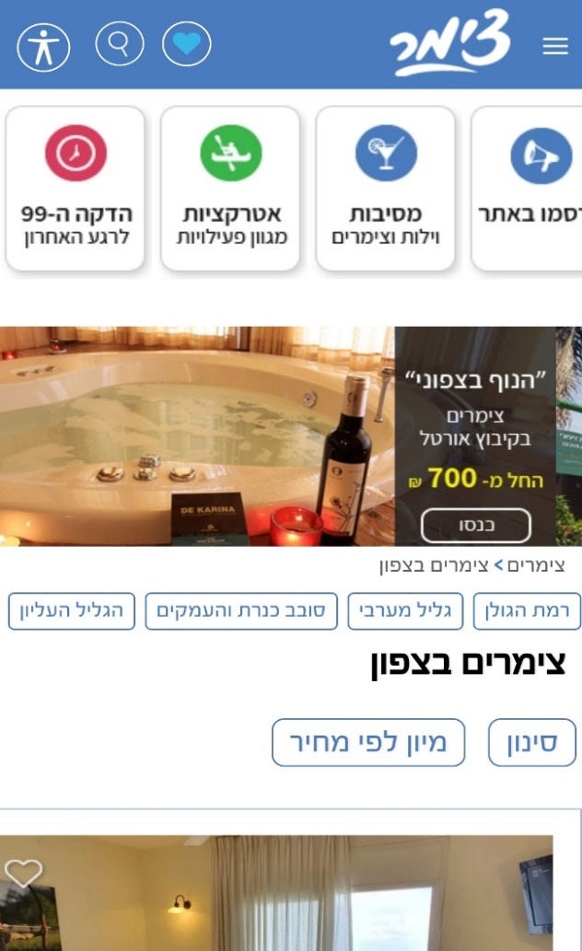
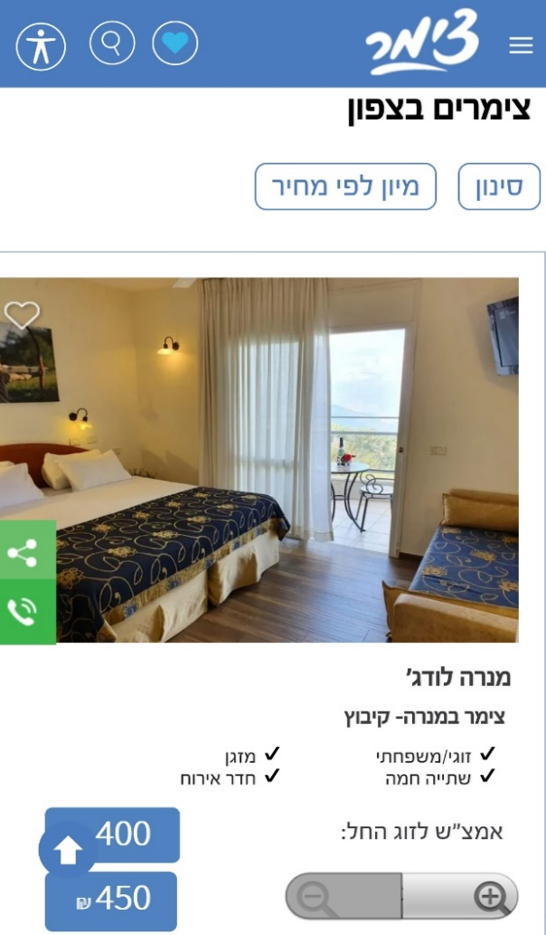

The Product structure is simple and based on providing users big number of results

Slide 7
The testing procedure was divided into three sections
Section 1
Exploratory Testing
Section 2
Following a Checklist
Section 3
Free Aiding Tools

Slide 8
Testing Environment
Samsung Galaxy S7 Android 8
Oneplus 5T A5010 Android 10
Oneplus 6T A6010 Android 10
LG G6 H870 Android 9
Xiaomi Redmi Note 8 Pro Android 10
Tablet Blaupunkt BP_6010 Android 9

Slide 9
The good news: The app does what it suppose to do functionally
It is possible to filter and select through units
It is possible to connect with unit owners
The 4 clicks principle
App and web relation – uniformity

Slide 10
More good new: The app does what it suppose to do in relation to the device
App and device relation (interface and integration)
Battery usage
Load time
Memory consumption
App in background
App simultaneously with other apps
Download, update and delete app
Interferences – incoming call, messaging, notifications, alarm
Localization
Network – 4G, 3G, wifi, flightmode, bluetooth
Orientation

Slide 11
The bad news: The app is a user experience nightmare
Response time
Who has the control? The app or the user?
No back/delete/clear options
No about page
No help option
No error messages when something goes wrong
No “book now” option
Covid-19
Accessibility
Options do not operate fully

Slide 12
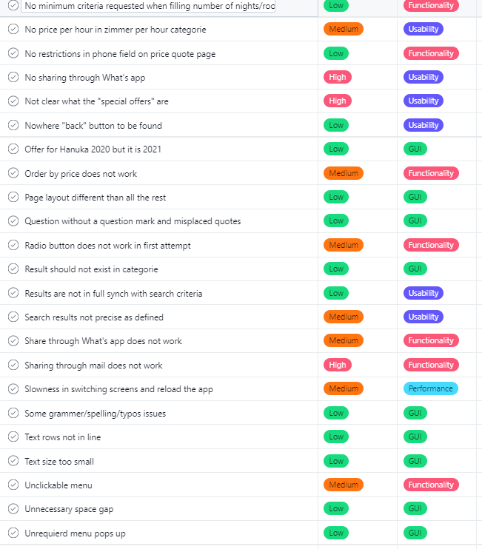
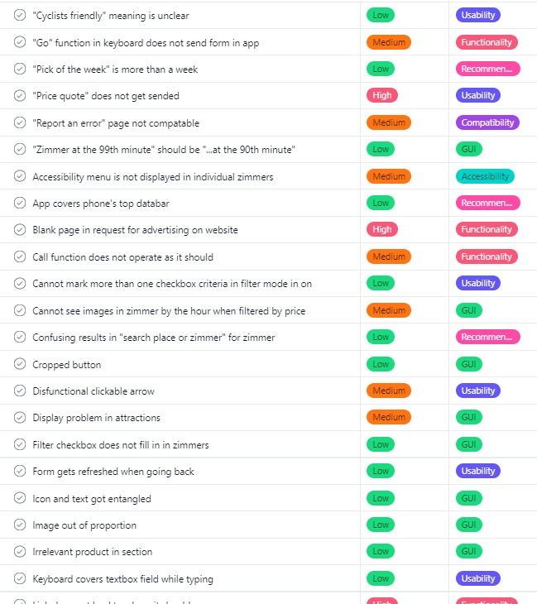
At least 50 bugs detected and reported via Asana

Slide 13
Bug Category
Severity

Slide 14
5 Bug Examples

Slide 15

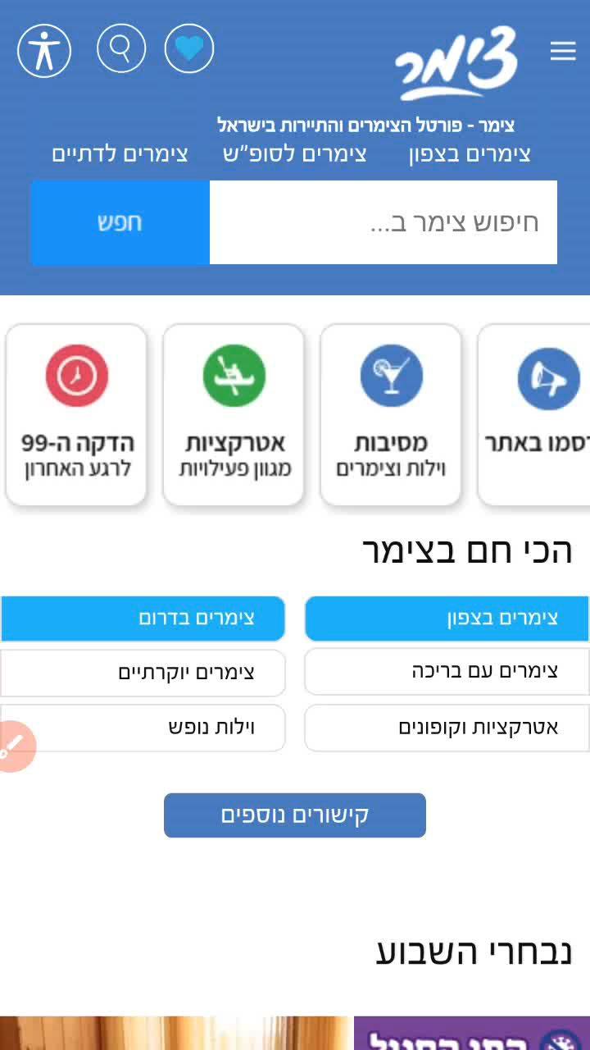
Performance

Slide 16
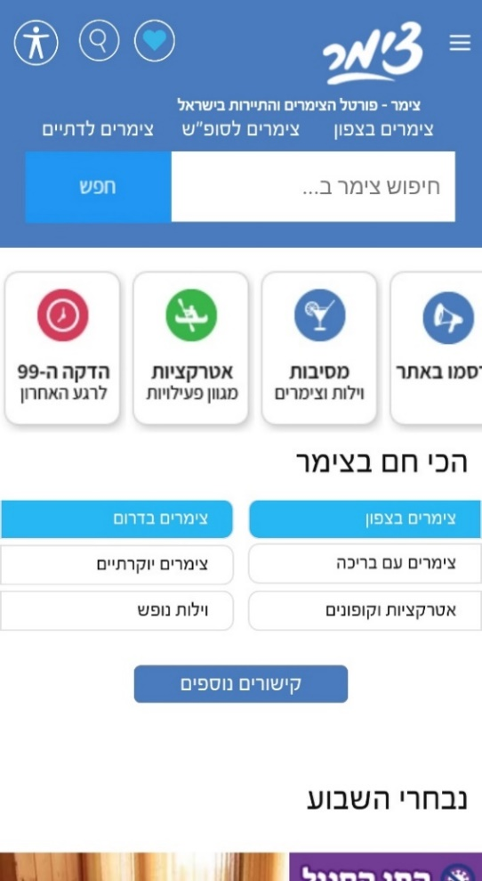
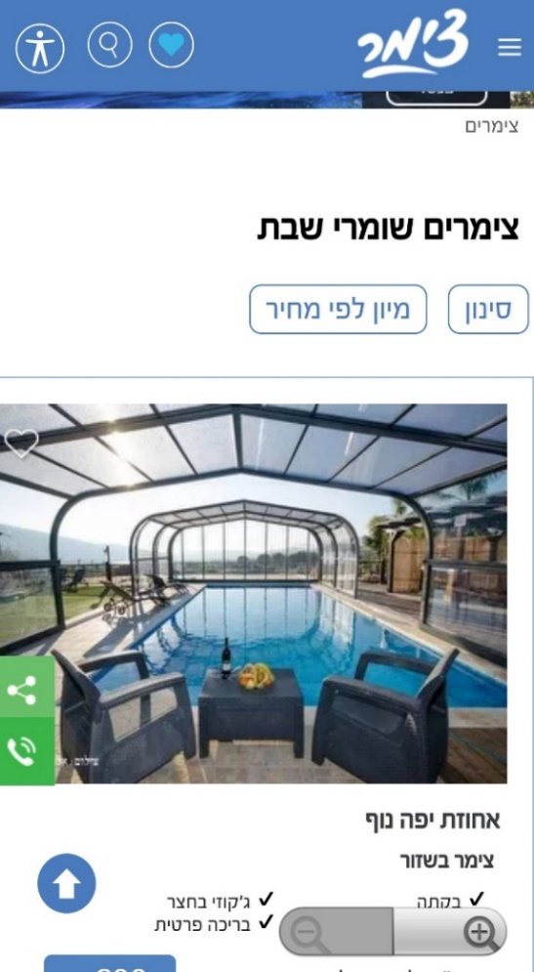
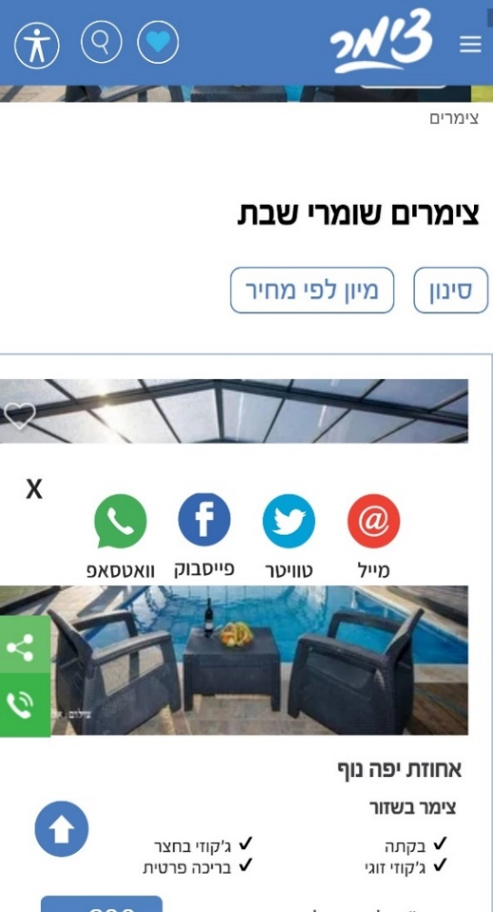
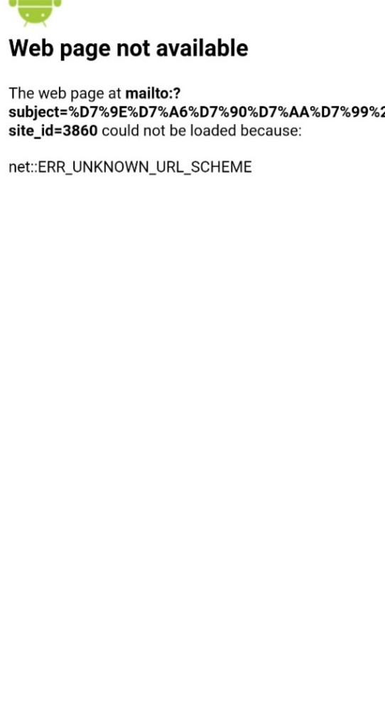

Functionality

Slide 17
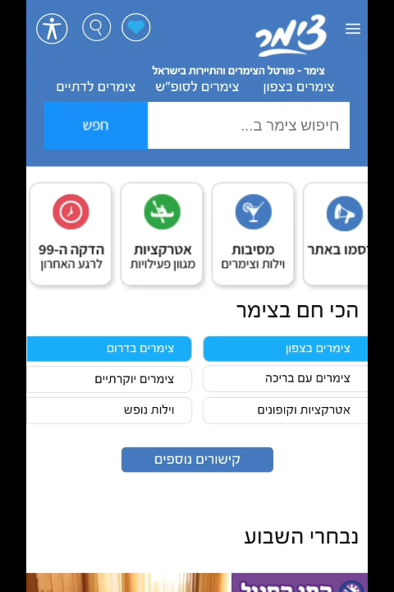
Usability

Slide 18
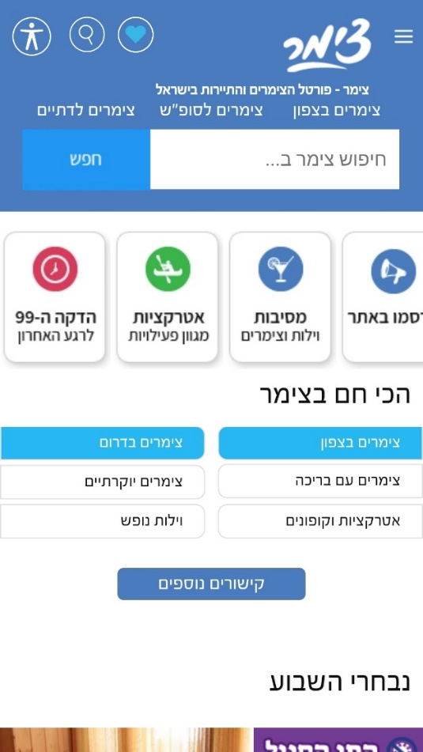
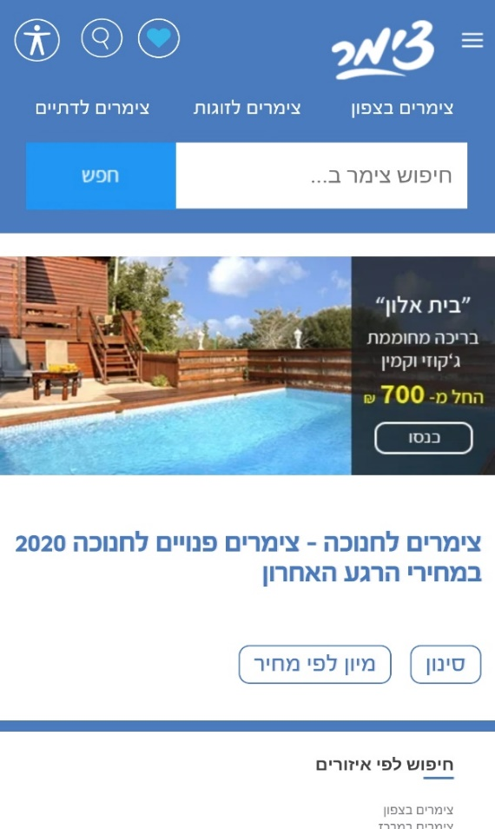
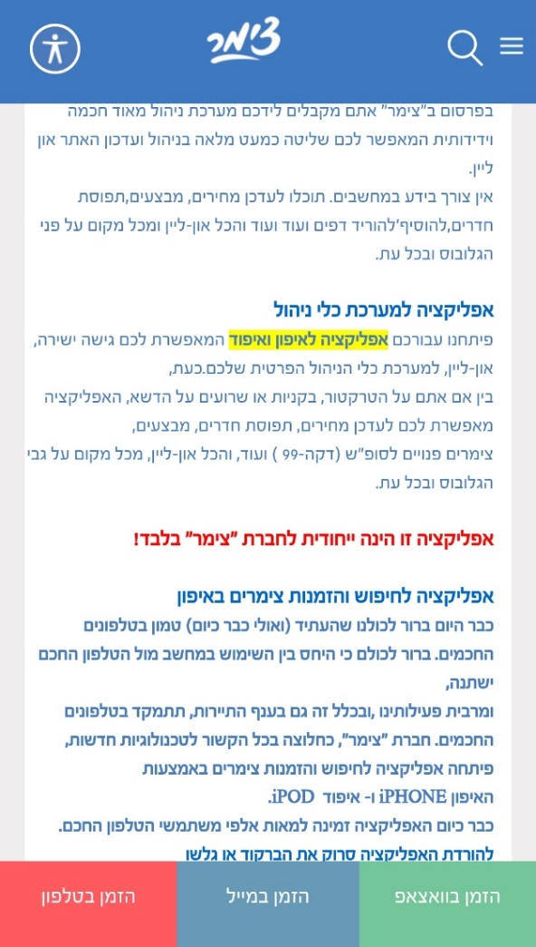
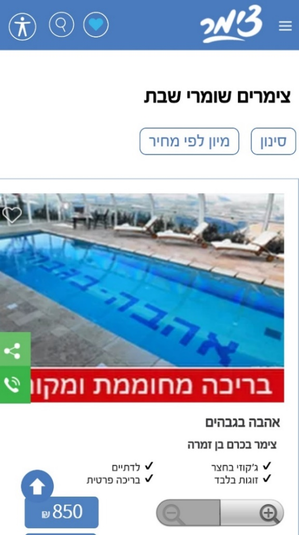
GUI

Slide 19
Accessibility

Slide 20








Recommendations and references

Slide 21
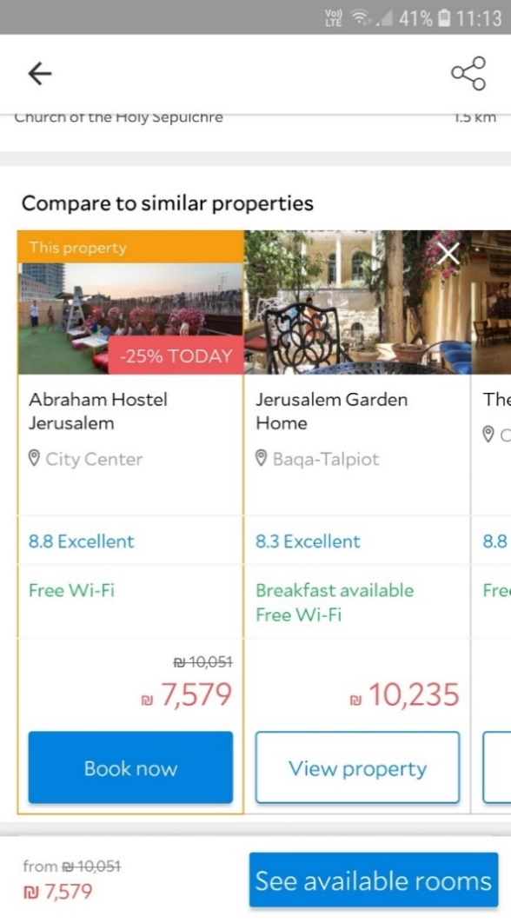
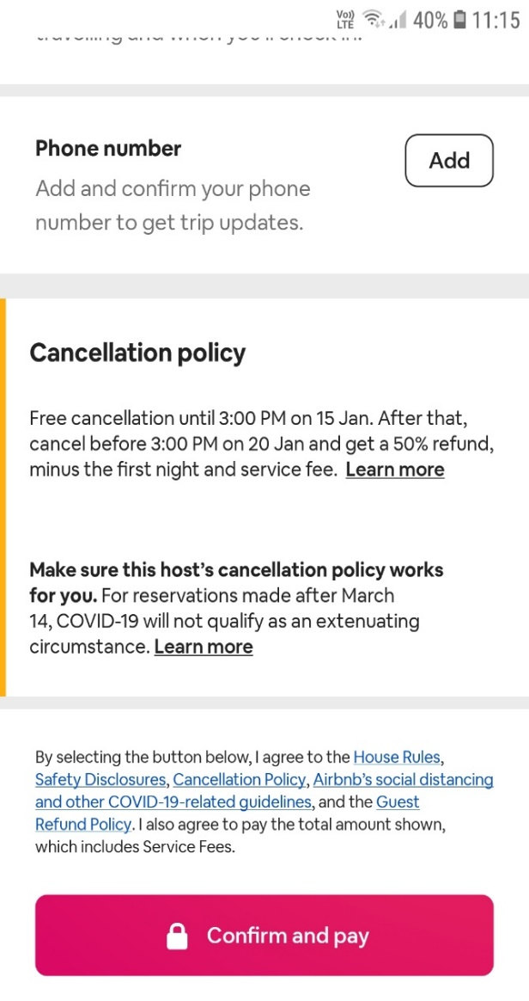
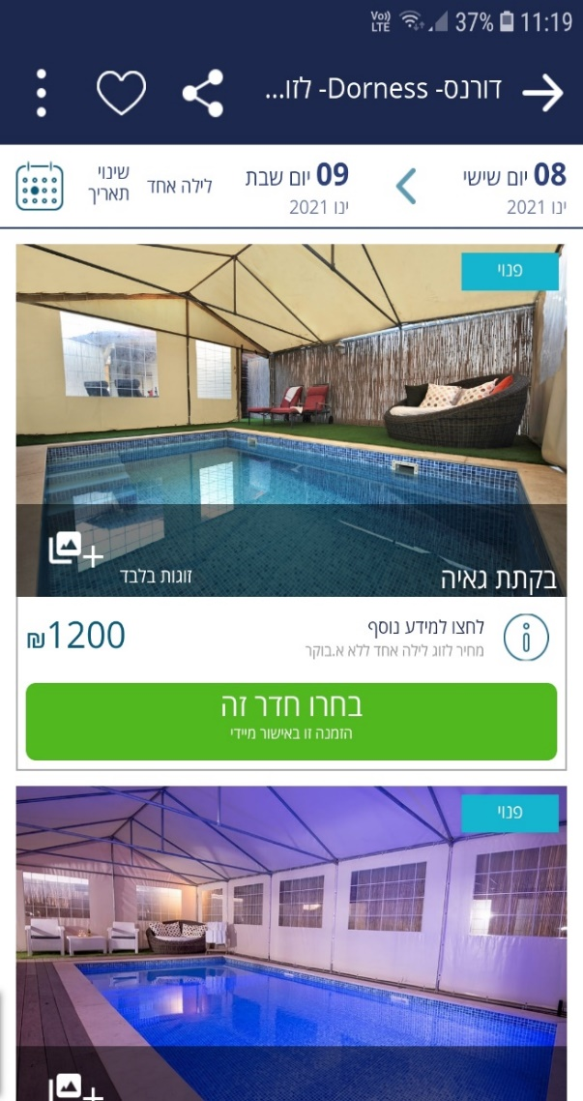
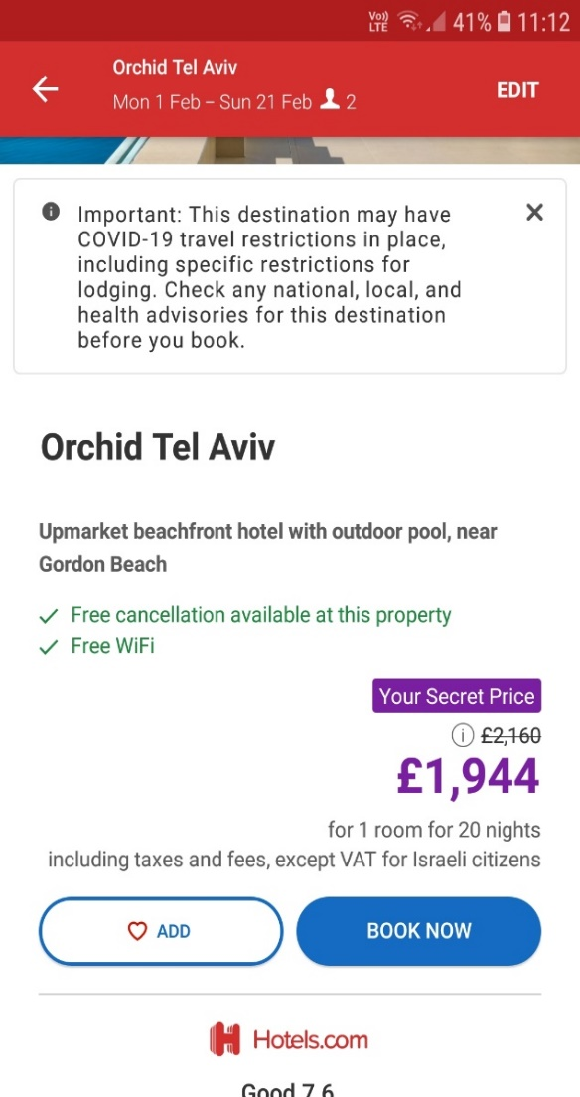
Make it easier for your users
to fulfill the transaction

Slide 22
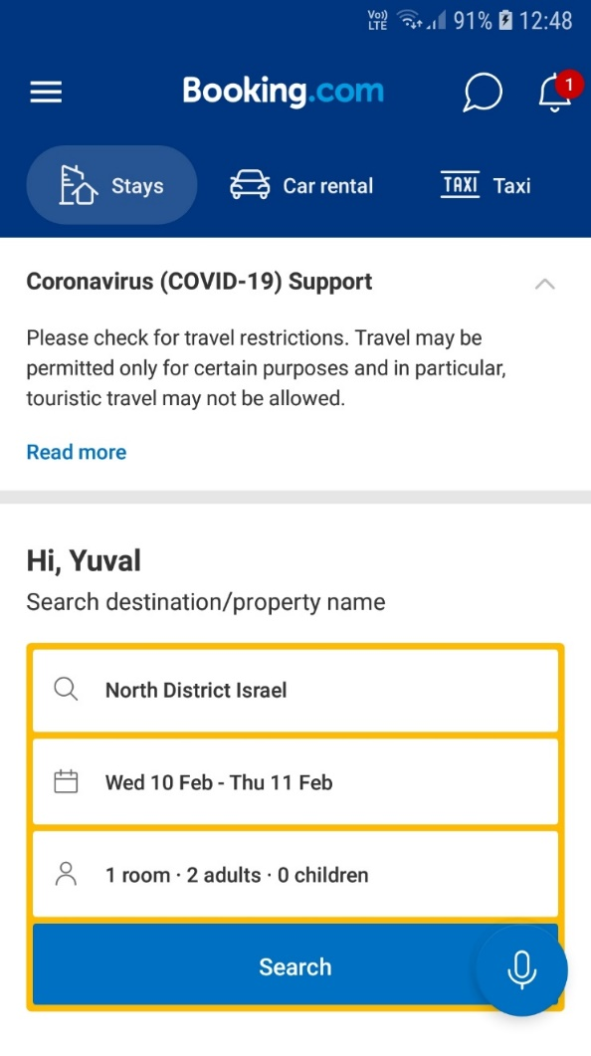
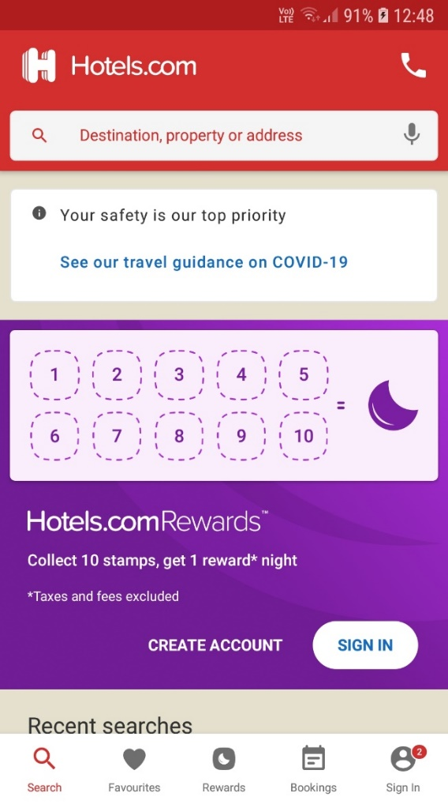
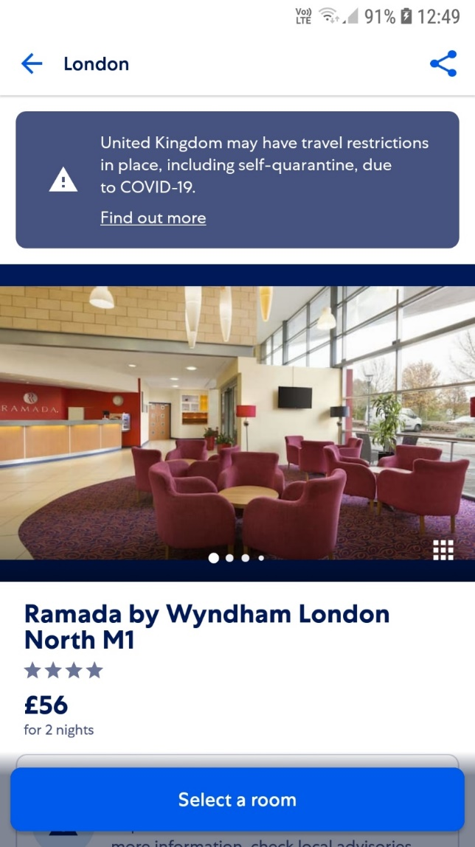
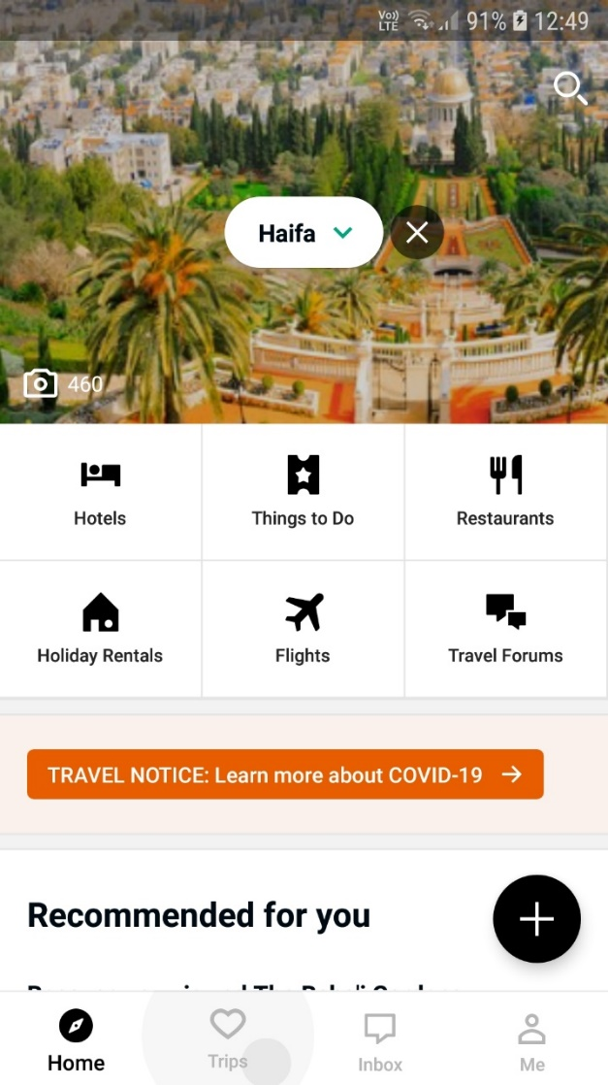
Be Covid-19 aware
and help your users understand restrictions

Slide 23
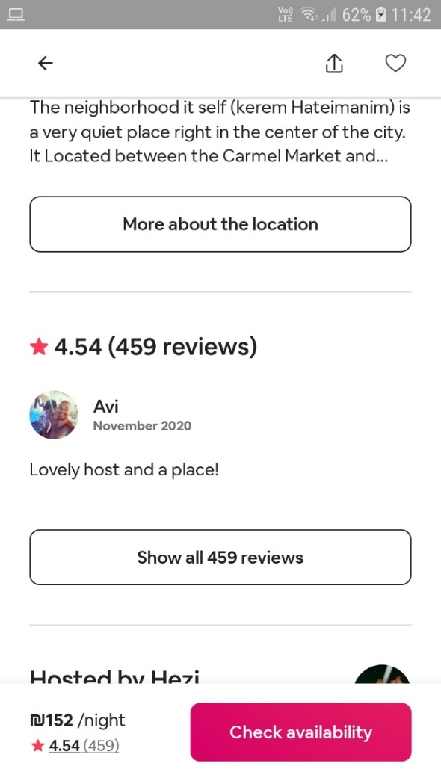
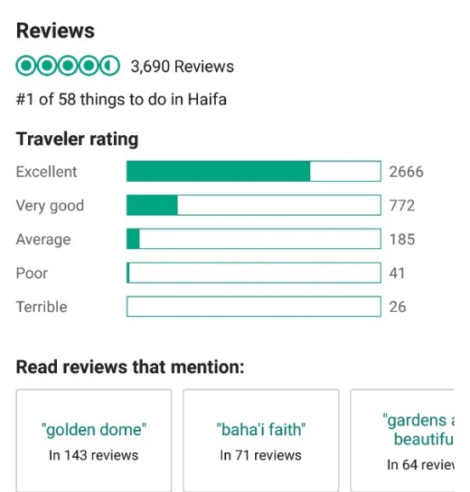
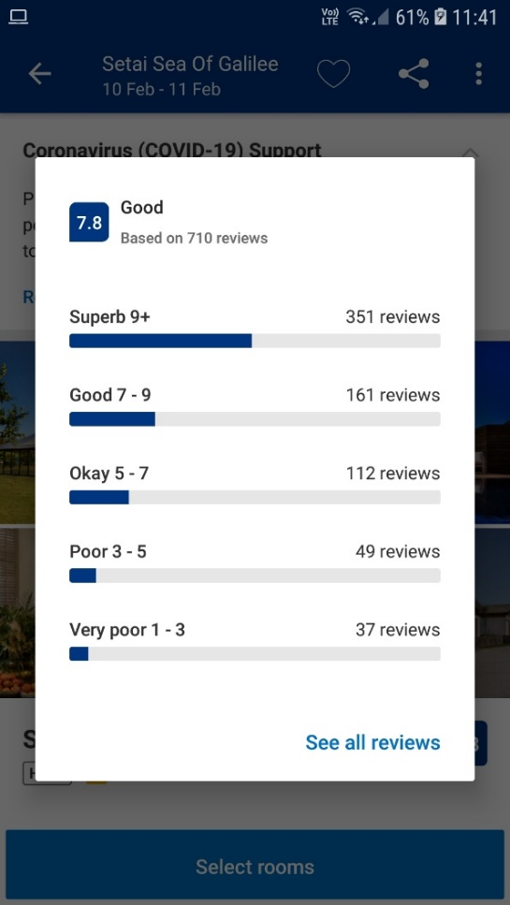
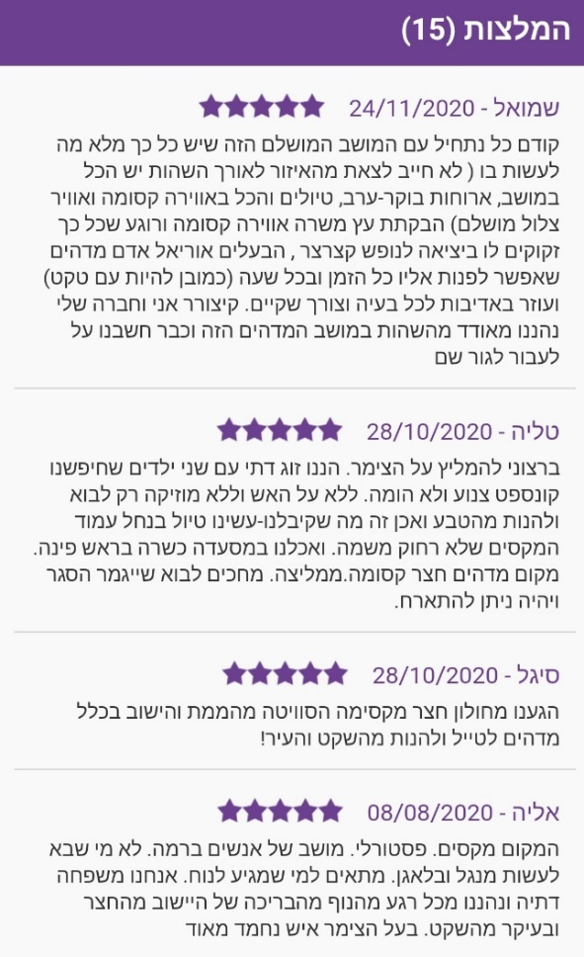
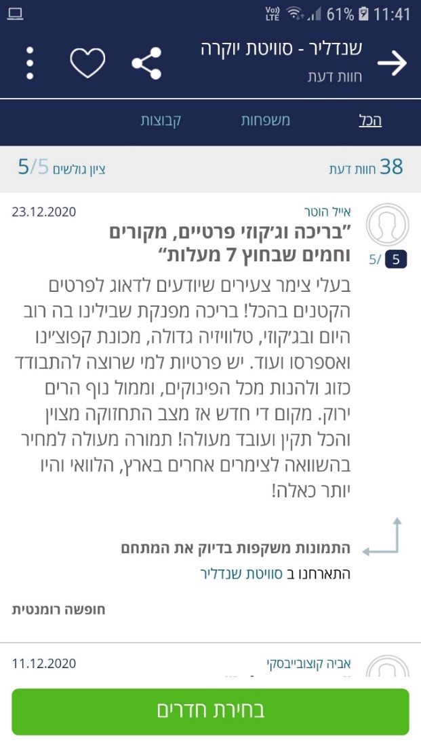
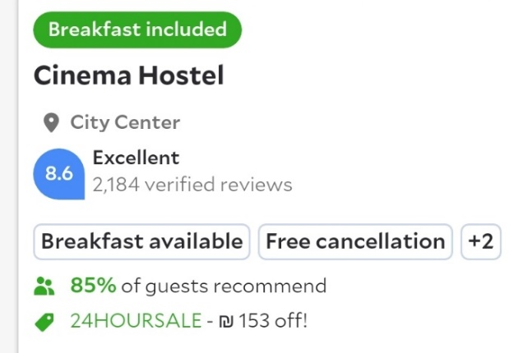
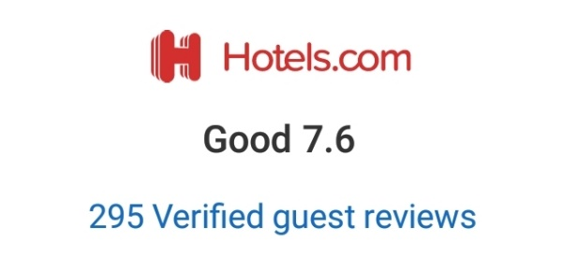
Be transparent and reliable
and gain your client’s trust

Slide 24

Conclusions
Zimmer provides a great solution for unit owners on the one hand, and potential clients, on the other
The Zimmer app interfaces perfectly with devices tested
Zimmer should consider improving their user experience

Slide 25
Thank You!
Yuval Raz | Raz Linetzki
January 2021

